Slide 1

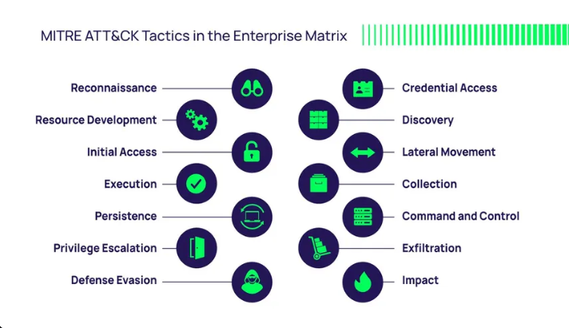
AI-Enhanced Breach and Attack Simulator
By Neha Kasera

Slide 2
Background and motivation
The growing sophistication and frequency of cyberattacks.
Organizations need to continuously test and improve their defenses.
Manual testing is time-consuming and resource-intensive.
Objective
To develop an automated tool that simulates real-world cyberattacks, generates synthetic security logs, and leverages AI for detection and analysis.

Slide 3
Problem Statement
Challenges in Cybersecurity
Security teams struggle to keep up with evolving attack techniques.
Traditional penetration testing is not continuous and can miss new threats.
Lack of realistic, labeled data for testing detection systems.
Difficulty in mapping security events to frameworks like MITRE ATT&CK.
Impact
Increased risk of undetected breaches.
Delayed incident response.
Compliance and reporting challenges.

Slide 4
Solution Overview
Project Overview
Developed a Python-based simulation tool for generating attack scenarios and logs.
Mapped events to MITRE ATT&CK tactics and techniques.
Integrated AI for breach narration and anomaly detection.
Key features
Scenario-based Attack Simulation: Predefined attack chains (e.g., Credential Theft, Ransomware, Phishing).
Synthetic Log Generation: Realistic logs with contextual metadata (timestamp, IP, user, event, MITRE mapping).
AI-Powered Analysis:
Attack narrative generation using language models.
Anomaly detection using machine learning.
Visualization: Interactive dashboards for log review and analysis.

Slide 5
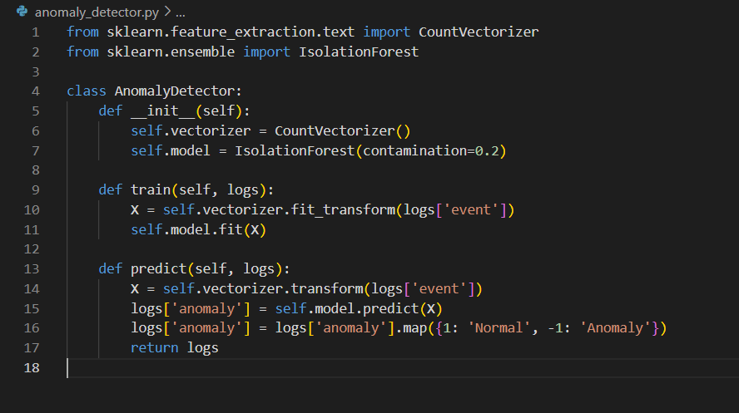
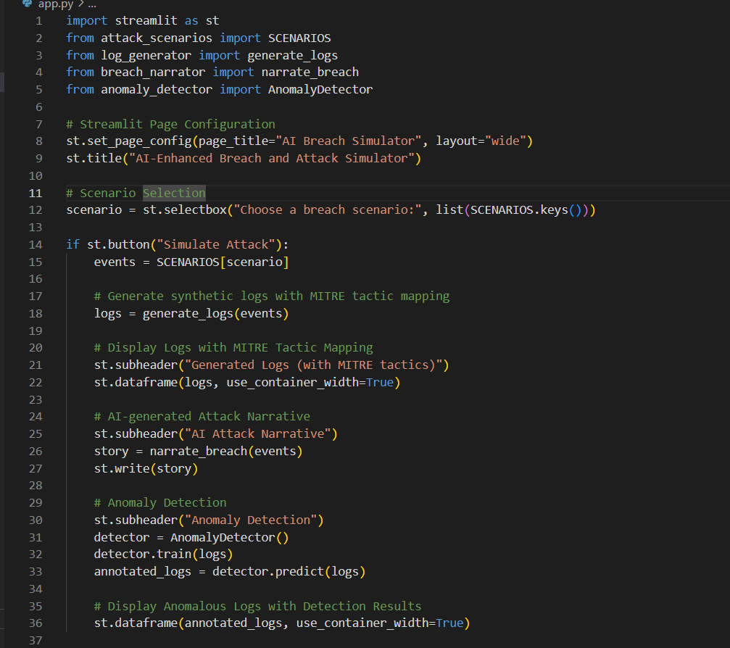
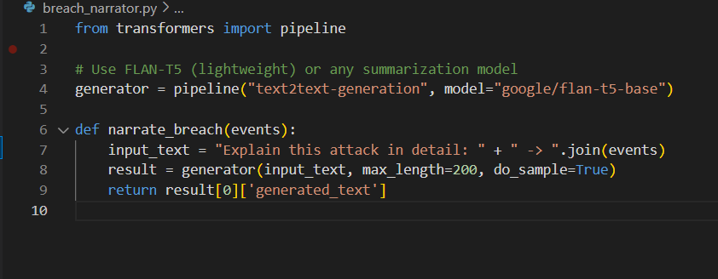
anomaly_detection.py
app.py
breach_narrator.py

Slide 6
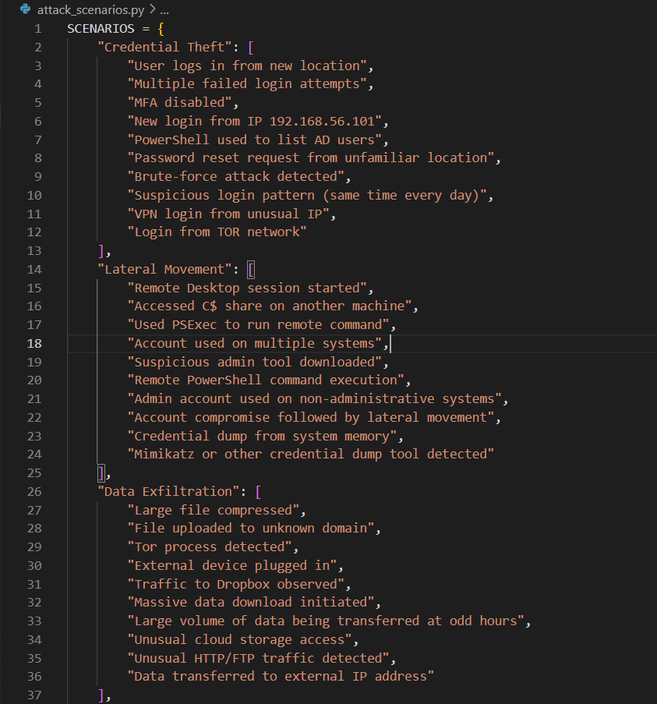
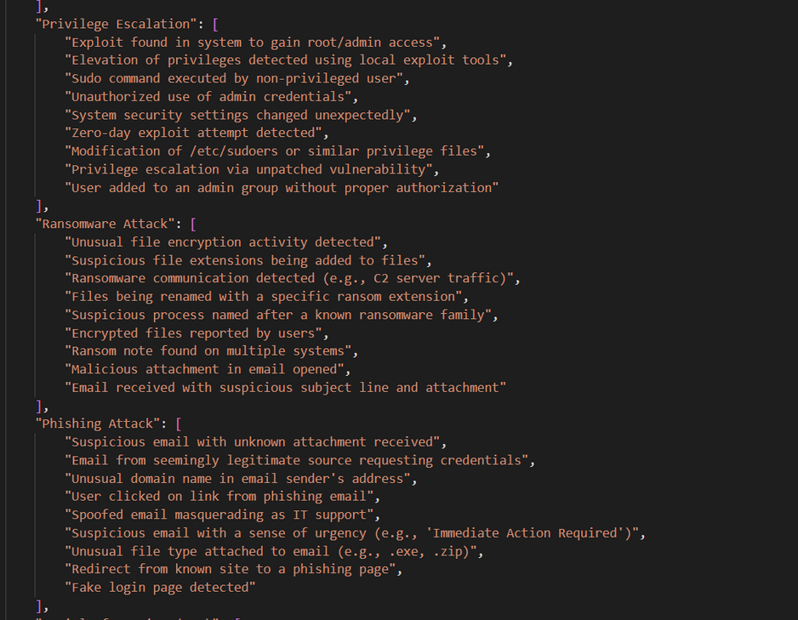
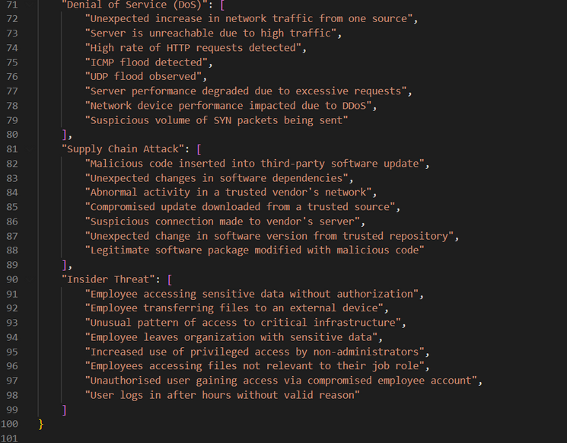
attack_scenarios.py

Slide 7
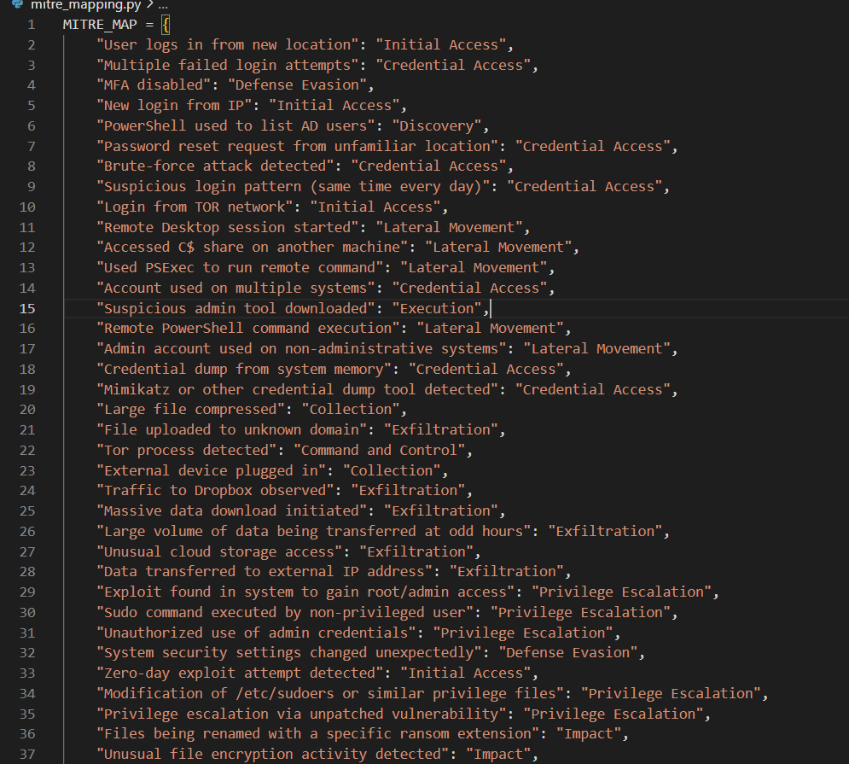
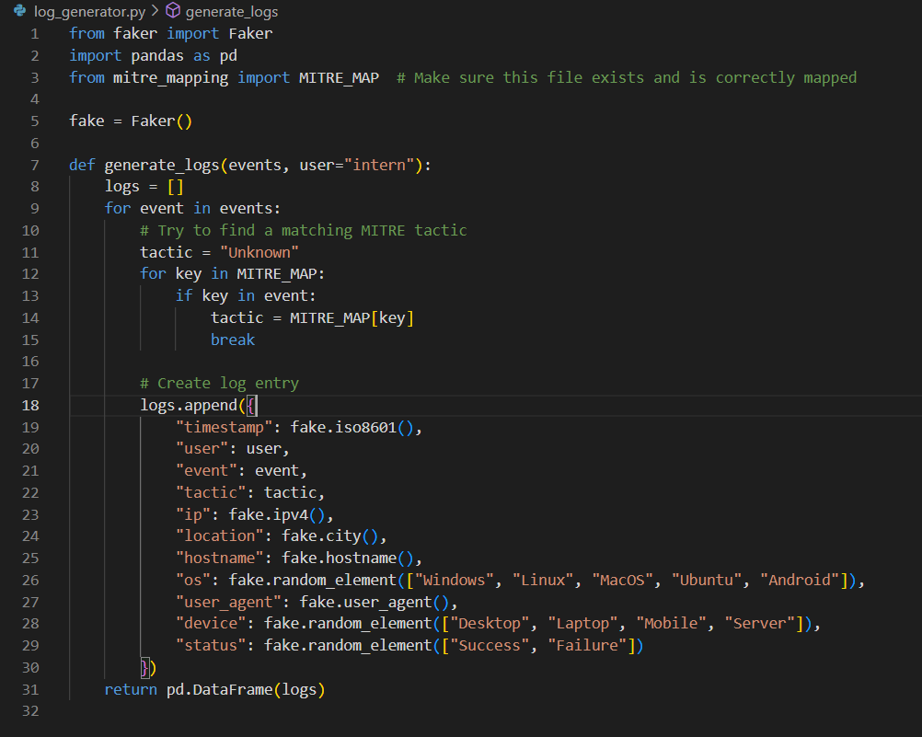
log_generator.py
mitre_mapping.py

Slide 8
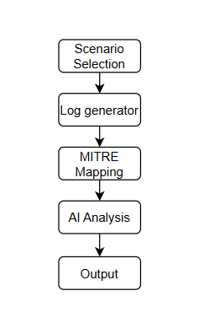
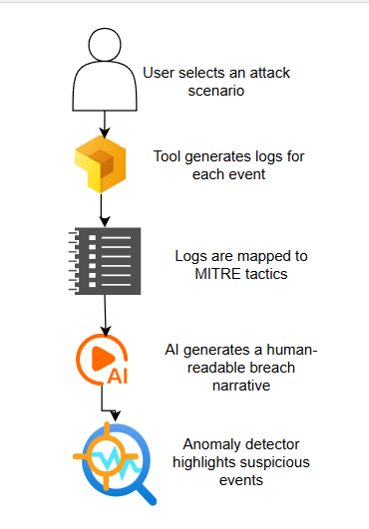
Code / Tool breakdown
Flowchart

Slide 9
Module_Breakdown
mitre_mapping.py: Maps security events to MITRE ATT&CK tactics and techniques.
log_generator.py: Generates synthetic logs for selected attack scenarios.
attack_scenarios.py: Defines multiple real-world attack chains.
breach_narrator.py: Uses AI (e.g., FLAN-T5) to generate a narrative of the attack.
anomaly_detector.py: Detects unusual events using machine learning (Isolation Forest).
app.py: Provides an interactive interface for scenario simulation and analysis.

Slide 10
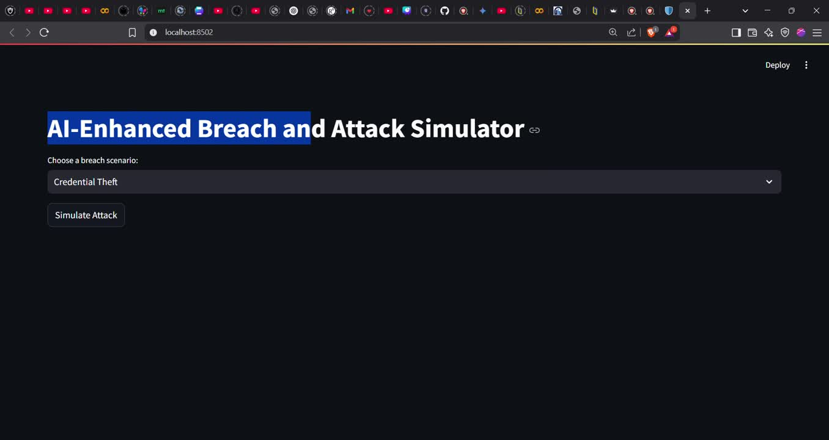
Demo video

Slide 11
Real world use cases
Security Operations Center (SOC) :
Use synthetic logs to test SIEM rules and analyst workflows.
Red Team/Blue Team Exercises :
Simulate attack chains to train defenders and test detection capabilities.
Tool Benchmarking :
Evaluate and tune anomaly detection or alerting systems using labeled, realistic data.
Compliance & Reporting :
Demonstrate continuous security validation and MITRE ATT&CK alignment for audits.

Slide 12
Future Enhancements
Expand Attack Library :
Add more sophisticated and diverse attack scenarios (e.g., supply chain, cloud attacks).
Integrate with Real SIEMs :
Directly feed synthetic logs into tools like Splunk, ELK, or QRadar for live testing.
Advanced AI Integration:
Use fine-tuned language models for more accurate breach narratives.
Implement deep learning for anomaly detection.
User Customization :
Allow users to define custom attack chains and log formats.
Visualization Improvements :
Add MITRE ATT&CK matrix heatmaps and time-series dashboards.
Automated Reporting :
Generate PDF/HTML reports summarizing each simulation.

Slide 13
Conclusion
This project demonstrates the design and implementation of an AI-Enhanced Breach and Attack Simulation Tool that automates the process of simulating cyberattacks, generating realistic security logs, mapping events to the MITRE ATT&CK framework, and leveraging AI for breach narration and anomaly detection.
Thank you

